Slide 1



Digital
Games
Game Design - 201
Tue 9:30-12:15pm C-456
Prof. McClure

Slide 2
Announcements

Slide 3
PREVIOUS HOMEWORK
RGR4
READ Level Up Chapter 12
PLAY Play one handheld game you like and two you dislike on Pica Pic
WRITE Relate the reading to the handheld games you played. What were the key mechanics? What worked? What was frustrating? etc.
GDD - Week 8 (3/29/16) - Post a link to the blog, clearly labelled with team member names
Game 1 Projects/Presentations -- Week 9 (4/5/16)

Slide 4
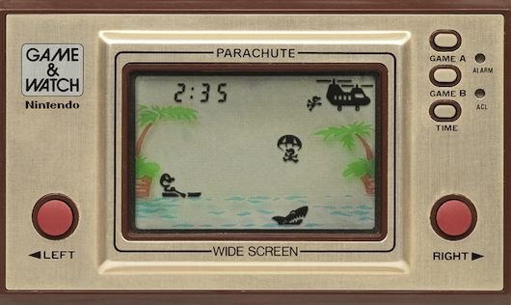
Pica Pic
R.I.P. 1970’s-1990’s

Slide 5
Good? Bad? Ugly?

Slide 6
What is it?
UX / UI

Slide 7
What makes for good UX/UI?

Slide 8
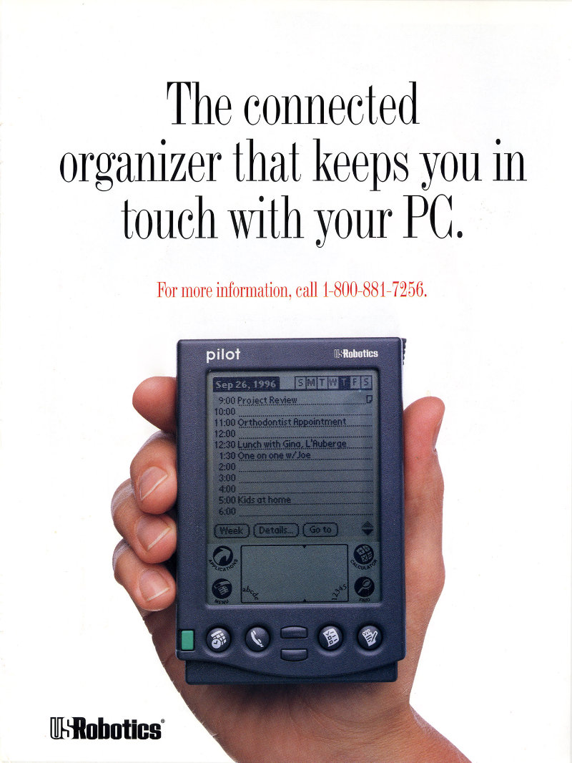
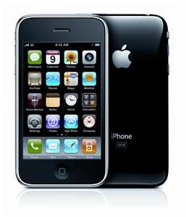
Notes:
Which one was considered revolutionary?

Slide 9
“The best interface is no interface.”

Slide 10
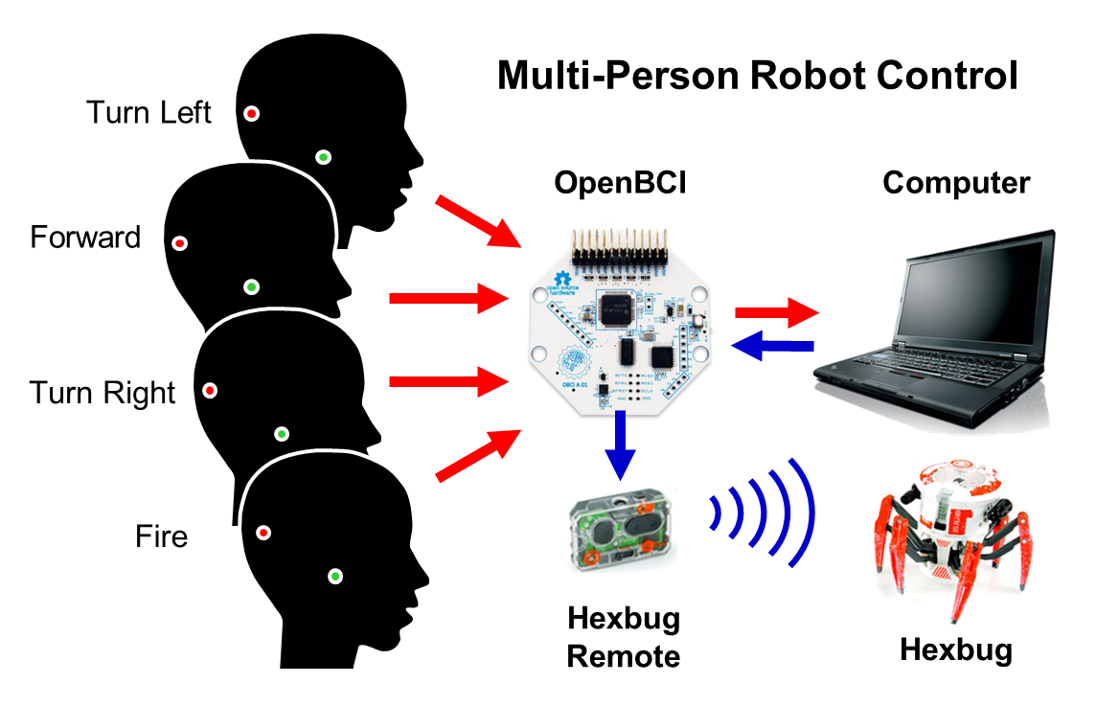
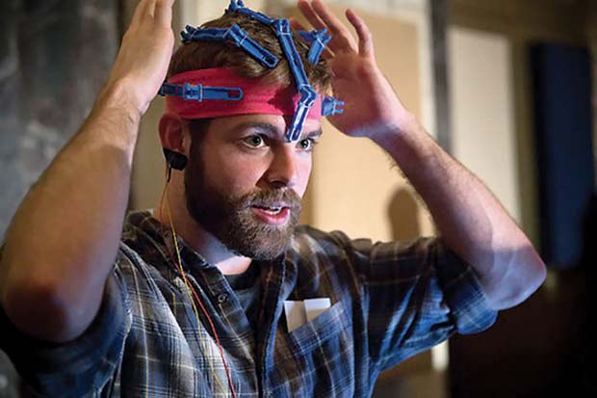

Slide 11
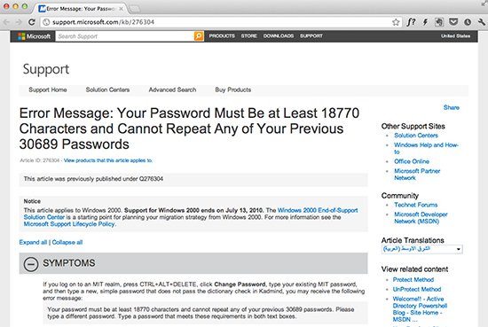

Slide 12
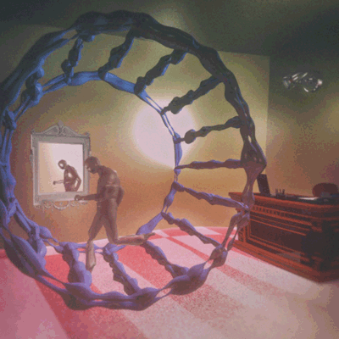
Manual Labor

Slide 13
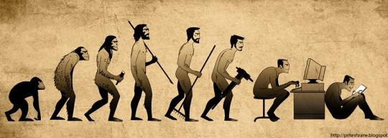

Slide 14
UI: Focus on user needs

Slide 15
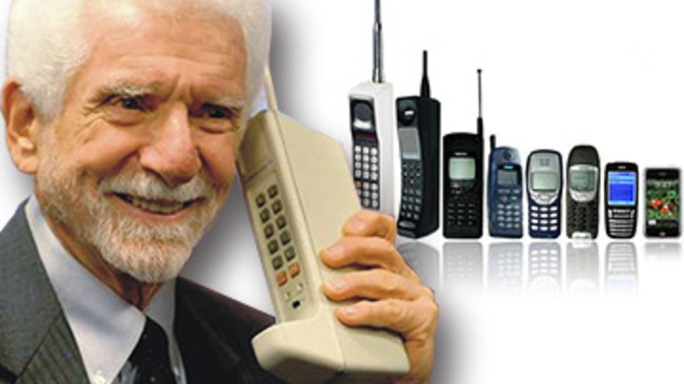

Slide 16
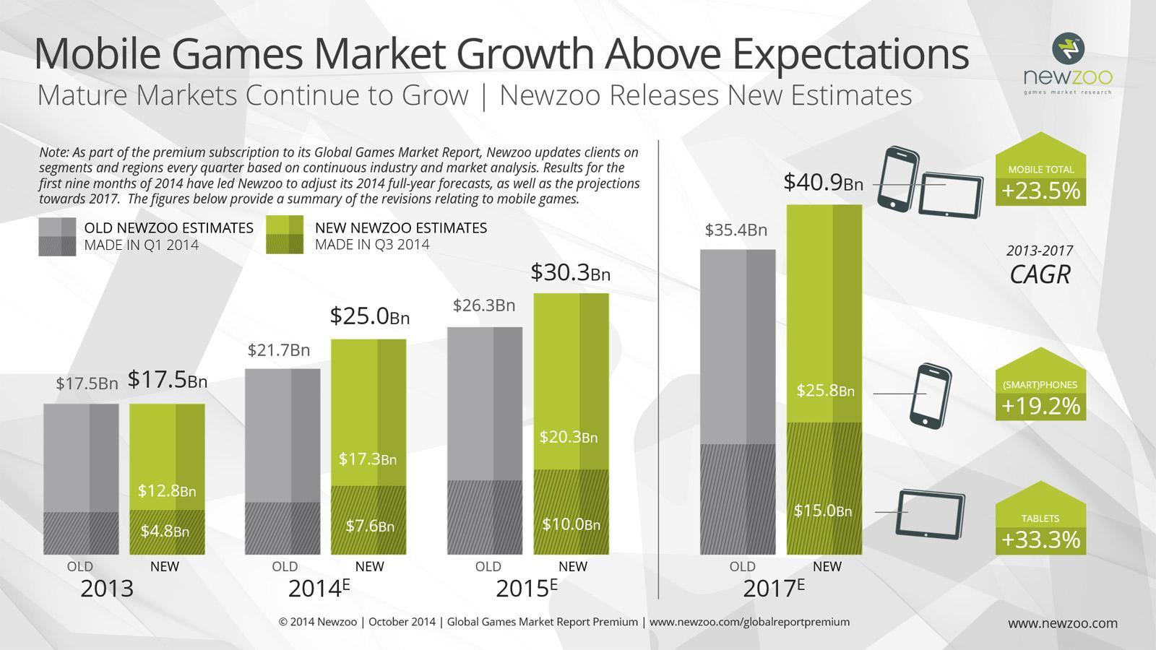

Slide 17
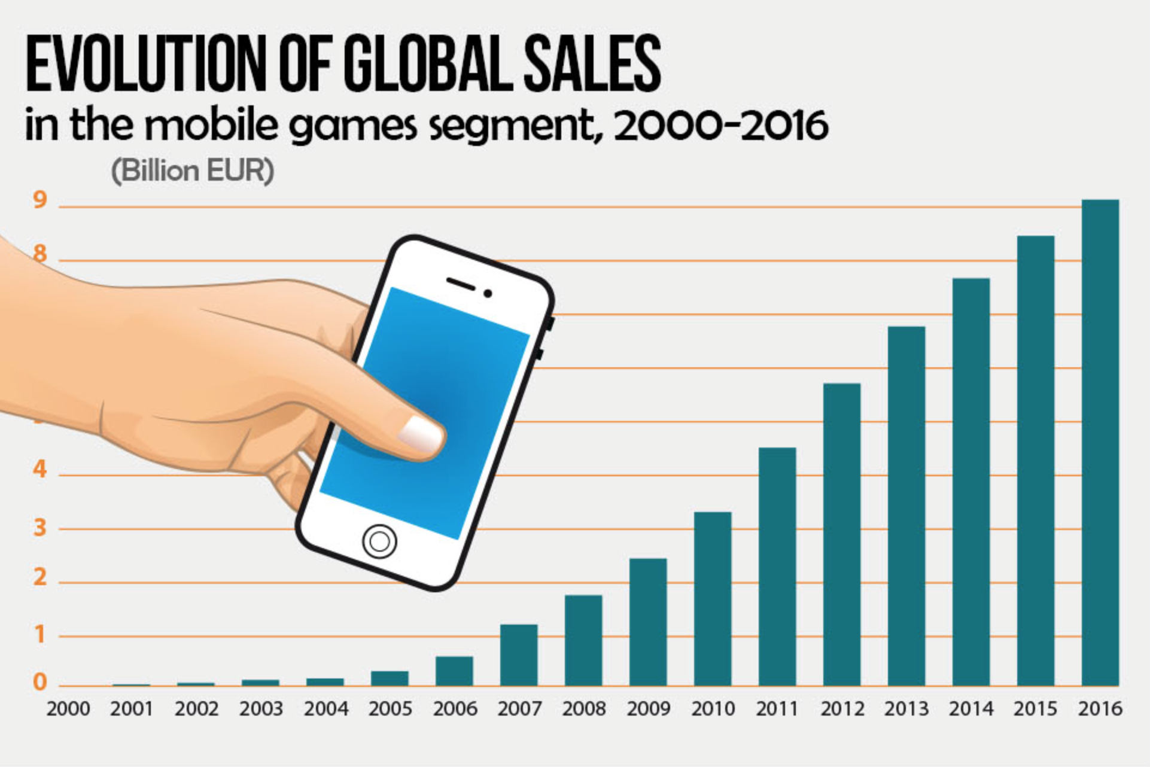

Slide 18
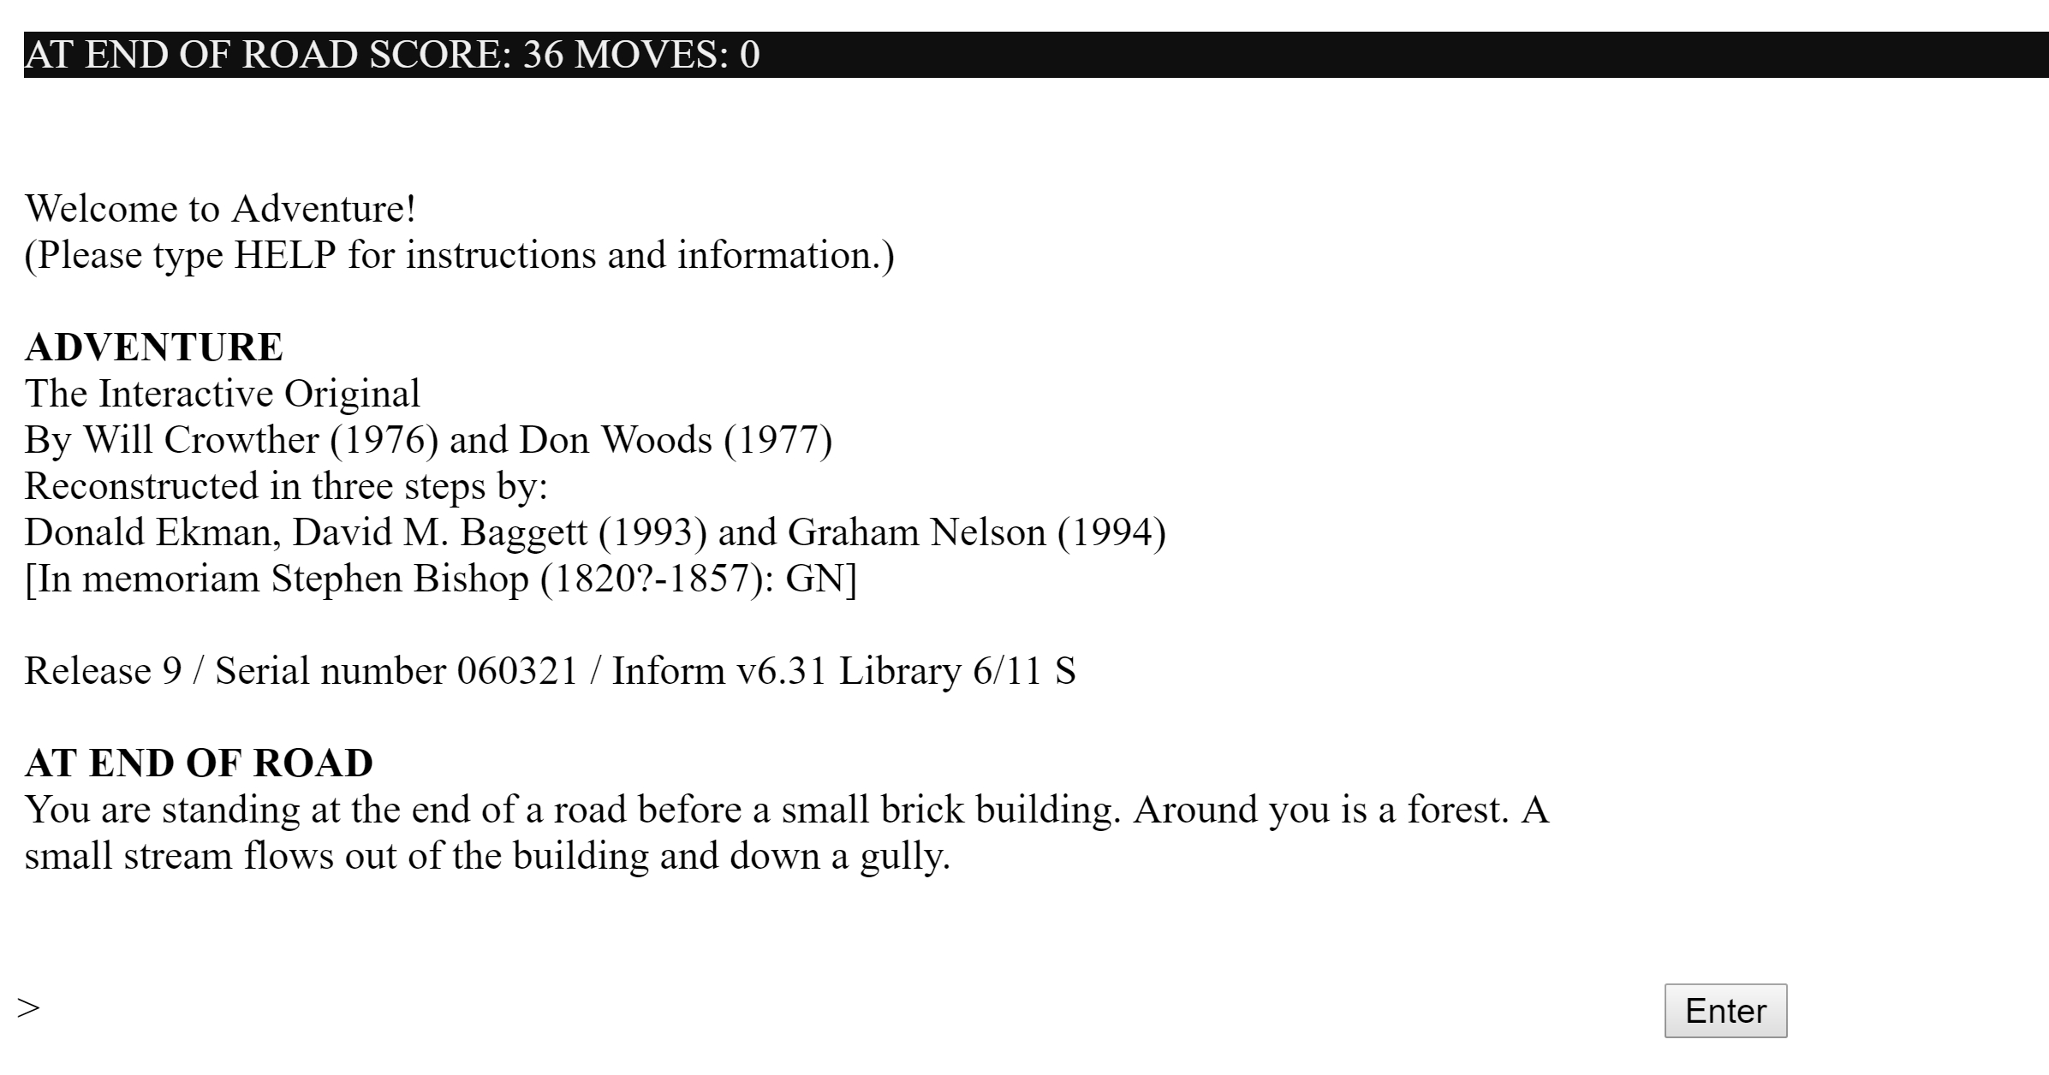
Notes:
Game interfaces

Slide 19
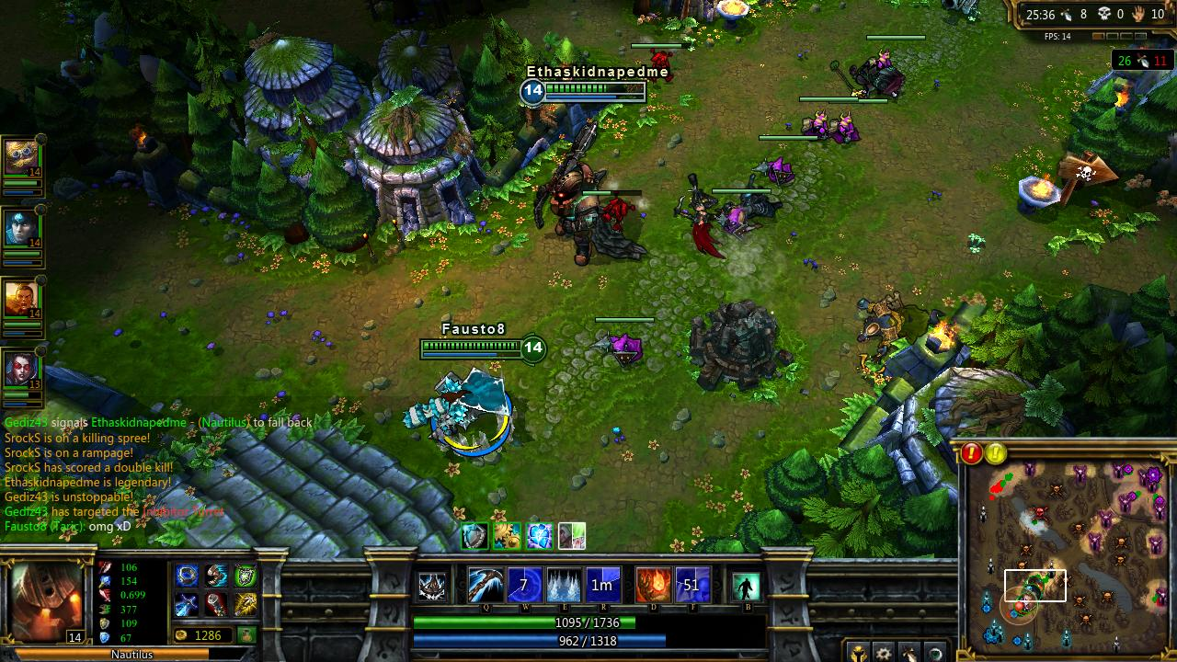

Slide 20
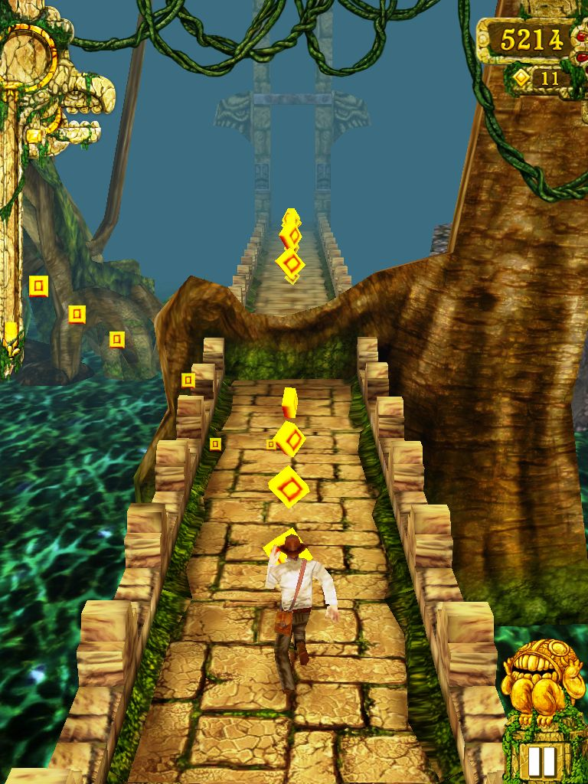
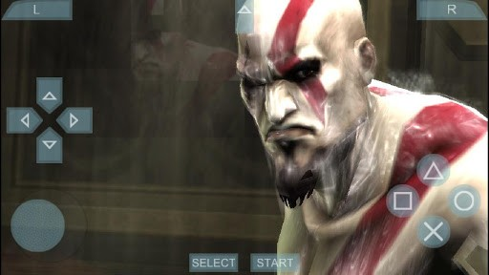
Notes:
Simple designed for mobile game vs terribly emulated game

Slide 21
Resources:
GoodUI.org
A/B Testing - tool/technique
UXPin - free books
Design Machines (article)

Slide 22
MOBILE UI EXERCISE
Use analog prototyping to design a mobile game interface for a collectible card game. What are the player interactions (swipe/tap/etc.) ?
Make the interaction as natural and intuitive as possible. It should anticipate their needs.

Slide 23
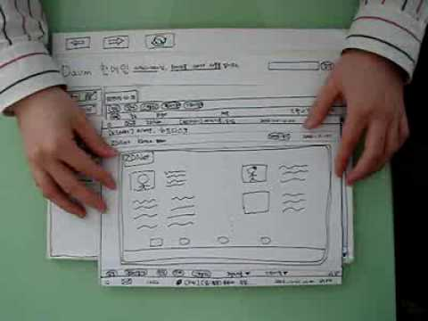

Slide 24
HOMEWORK
Document your mobile UI through photos and written descriptions. Share on the blog as a post with both of your names.
GAME 1 PRESENTATIONS & PLAY SHARING
Upload games to itch.io and share the link on the blog.
Game must be available for download by all interested parties!! i.e. the public

